Slide 1
WHY
Study in Details

Slide 2
Why we are analyzing?
Why we should study training materials in details?

Slide 3
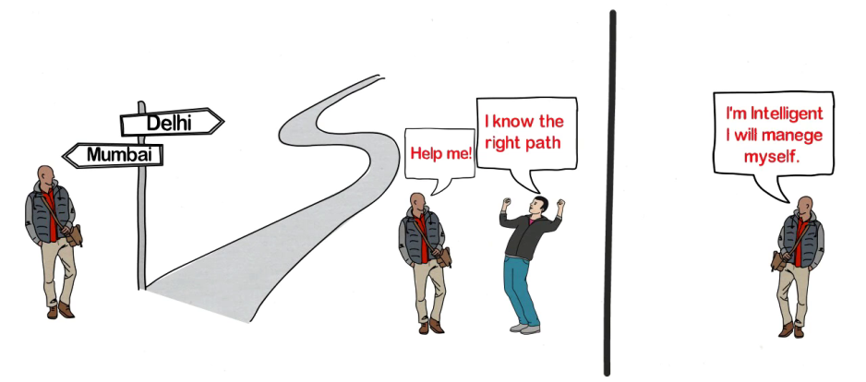

Real Life Scenario
x
$$√$$

Slide 4
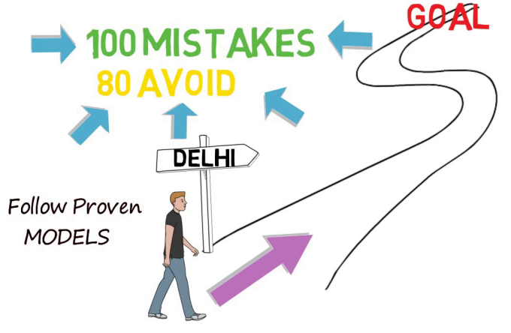
Benefit to follow proven models
Intelligent Work/Smart Work
Chances of Success

Slide 5
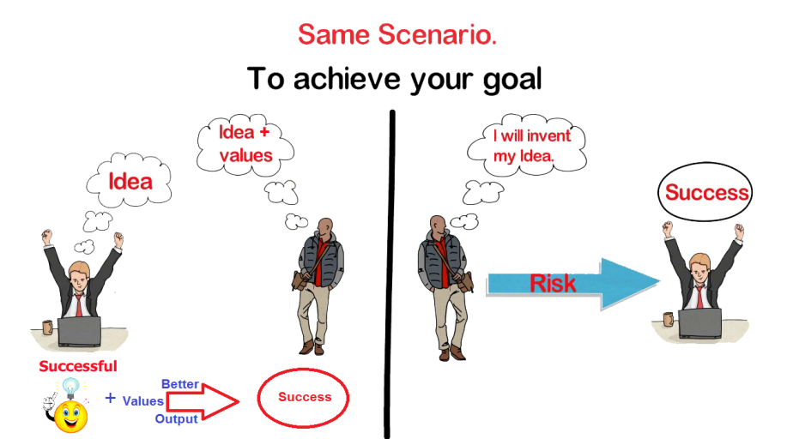

Slide 6
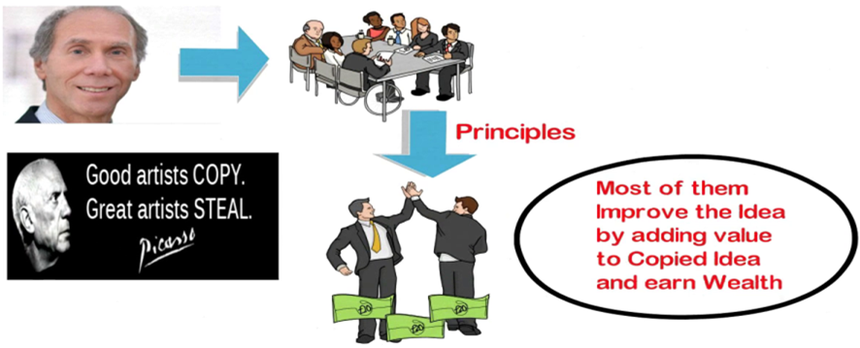
Book
How to Be a Billionaire – Proven Strategies from the Titans of Wealth
Martin S. Fridson
Leader
Apple-I phone-touchscreen
Follower
Samsung, Xiaomi

Slide 7







Original Innovation | Inspired Execution
Ben Franklin MS-DOS | Microsoft

Slide 8
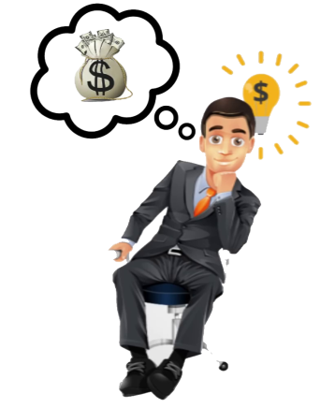
Success Formula

Slide 9
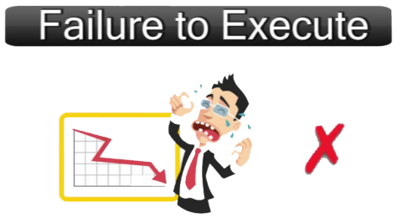
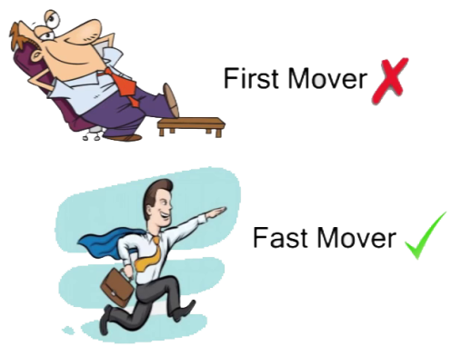
Seamless Execution On Inspiration
Can Become Even
Bigger Than Innovation

Slide 10
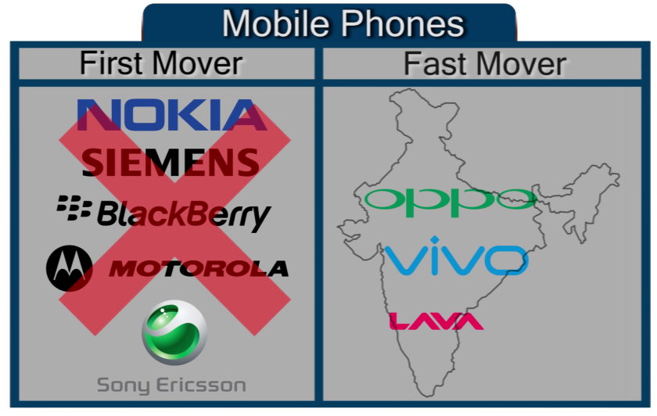

Slide 11
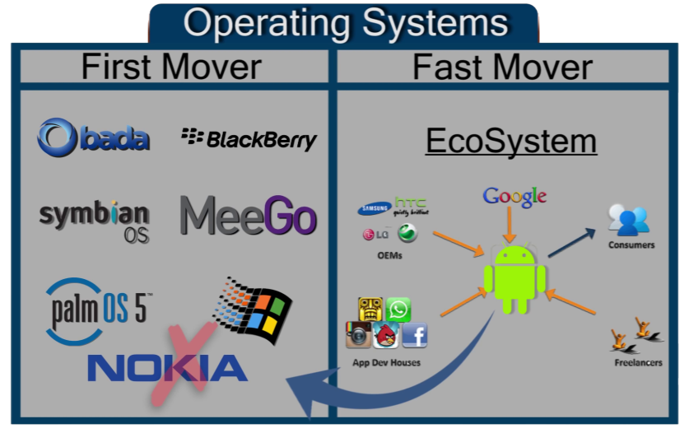

Slide 12
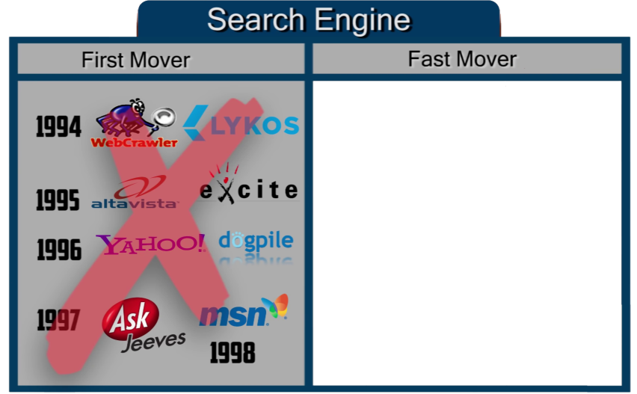

1998

Slide 13
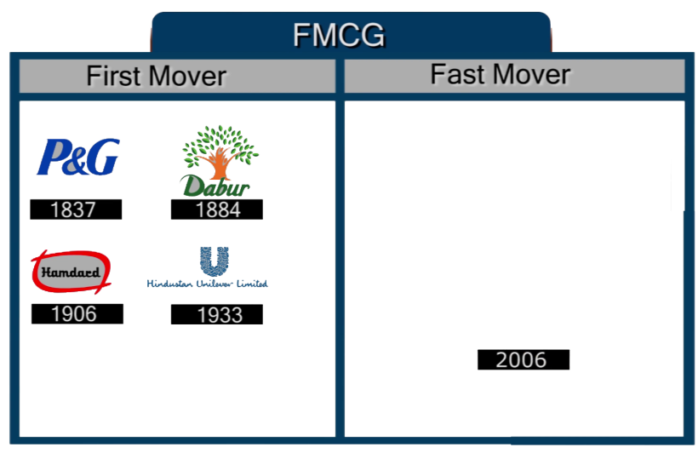
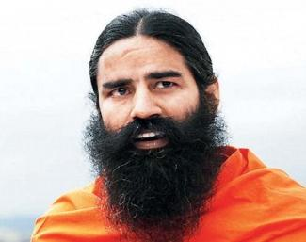


Slide 14
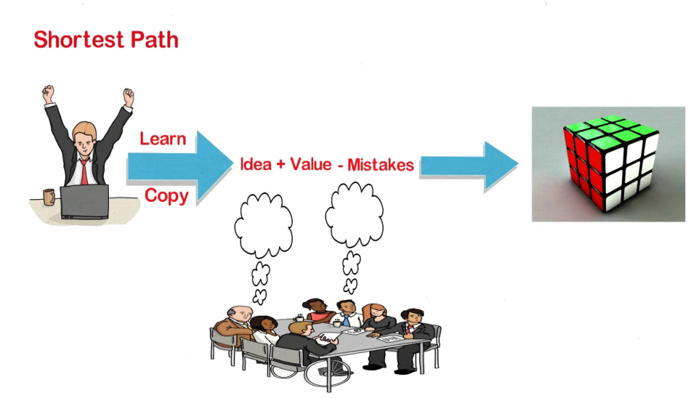
Execution Excellence
Successful
Benefits
Save Time
Avoid unnecessary work
Avoid Mistakes
Increase Chances of Success

Slide 15
Follow Successful Peoples
Proven Moldes
(SMARTCUT)

Slide 16
Successful Models ,Concept
DISC Model
The Myers-Briggs Type Indicator® (MBTI®)
The Behavioural Formula
The Johari window
The Situational Leadership® Model
Belbin Team Roles
M,V,V (Mission ,Vision Value)
Business Model Canvas
Goal Setting,PDCA,5 Why
Hoshin Kanri
SWOT,TOWS analysis
OJT

Slide 17
Let’s analysis more
Successful People
Successful Companies
Autobiography
Biography
Biopic
Podcast
Interview

